Slide 1
4/2 Class 11 – Healthcare Fraud
Clustering algorithms k means, hierarchical
K nearest neighbor model
Healthcare claims fraud solutions
Homework 9: Feature selection for Project 3
Time behavior of fraud scores
Some ways to approach Project 3 models

Slide 2
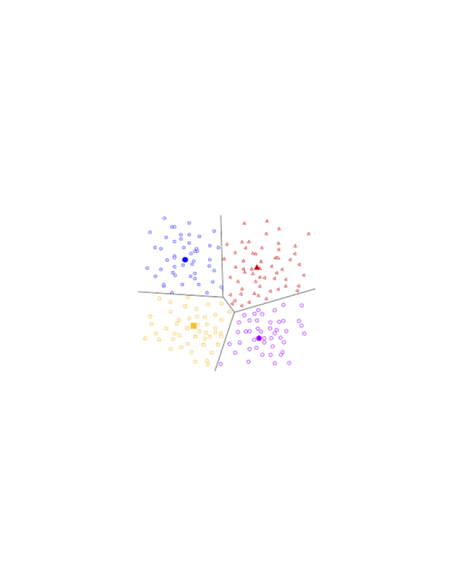
Clustering Algorithms
Gather entities/points into groups/clusters based on some criterion involving nearness
Need some metric of nearness or similarity
If metric depends only on the independent variables x then the method is unsupervised
If metric depends only on the dependent variable y then the method is supervised
Can be arbitrarily supervised, unsupervised or mixed
Nice tutorial: https://scikit-learn.org/stable/modules/clustering.html

Slide 3
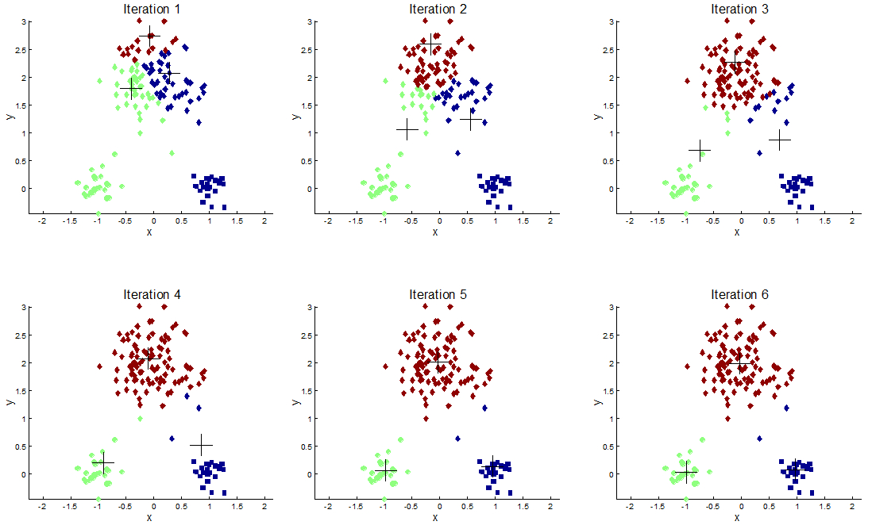
K-Means, Fuzzy C-Means - Unsupervised
Unsupervised modeling method – finds natural groupings of data points in independent variable (x) space
Parameters: k
3

Slide 4
Clustering in High Dimensions is Dangerous
Clustering of points in 1-d.
8 closest points to the yellow
Add a new dimension with noise
Clustering of points in 2-d.
8 closest points to the yellow are in the circle
Very different set in the cluster
Every new dimension brings noise, increasing the chance that the clustering is less meaningful.
Minimize dimensions, only use features with strong signal.

Slide 5
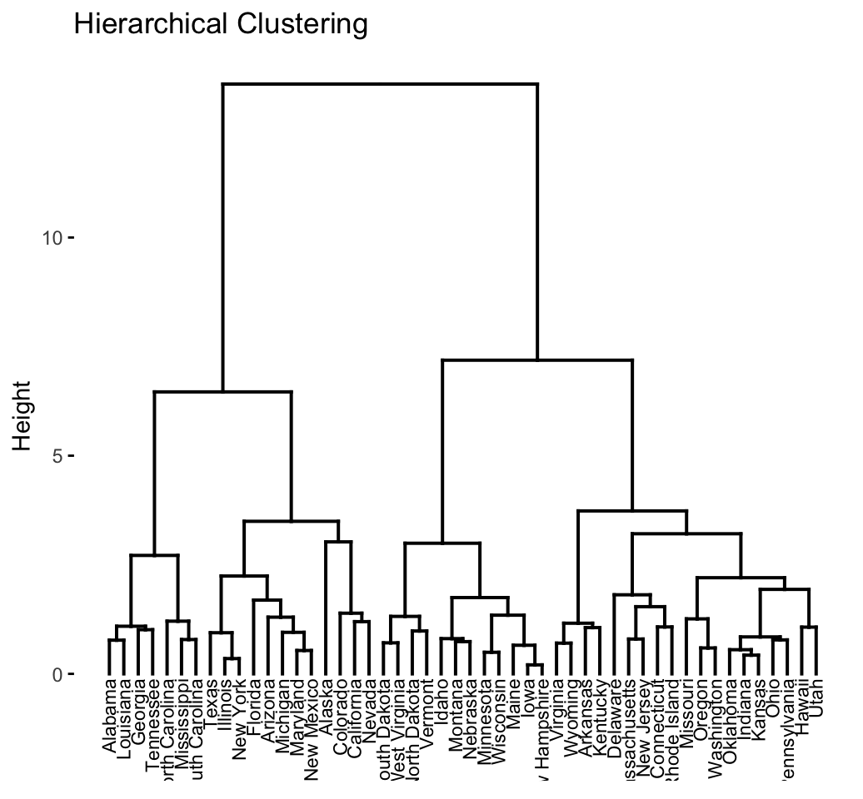
Hierarchical Clustering Analysis (HCA)
HCA builds a hierarchy of clusters, with large cluster being further broken into smaller clusters
Need to have a measure of nearness (Euclidian, Levenstein…)
Similar to stepwise feature selection, hierarchical clustering can be top-down or bottom up (agglomerative)
The results can be shown as a dendrogram:
One can then use a threshold to decide how many final clusters to have
Useful when objects have a natural hierarchy (procedure codes, transaction MCC codes, product category codes…)
The user can set a threshold wherever desired

Slide 6
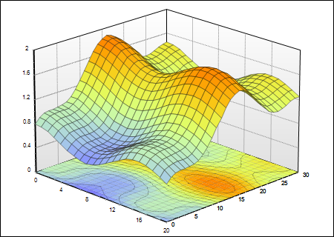
K Nearest Neighbors Model
Look at max, min, mean, sd’s, distributions, do normalizations
y
Data matrix after creation of variables
x₁ x₂ x₃ … x_{n} y
x₁ x₂ x₃ … x_{n} y
Many
millions
x₁ x₂ x₃ … x_{n} y
x₁ x₂ x₃ … x_{n} y
x₁ x₂ x₃ … x_{n} y
…
x₂
x₁
Many hundreds
Think this way for data preparation, statistical analysis, normalization, standardization…
Think this way for model building process, algorithm design and selection
3) Prediction for y is average of the nearest neighbors in x space
y
KNN is NOT a clustering method
It is a predictive model y=f(x)
x₂
x₁
1) Point in x space for which you want to predict y
2) Find the K nearest neighbors in x space

Slide 7
Healthcare Fraud and Abuse Problem - Engagement
In 2006 United HealthCare came to ID Analytics. Said they’d worked with FICO, IBM, SAS and weren’t satisfied with the results.
We negotiated a complicated multiyear, multimillion $ contract planned to grow with ongoing improvements.
To sign the contract they pressed us to tell them what we could achieve: fraud detection rate and false positive rate. I politely, consistently refused, and we still got the deal.

Slide 8
Healthcare Fraud Problem - Business/Technical Situation
Complex rule system in place. ~300 rules, all conflicting with each other. Fragile, hard to understand and maintain. They needed a different approach.
They had a robust team of experts, both technologists (rule writers) and investigators.
Had no labeled frauds that they wanted to share, so the algorithms had to be unsupervised.

Slide 9
Healthcare Fraud and Abuse
Entities:
Patients (people)
Providers (doctors, nurses, therapists…)
Facilities (hospitals, clinics, offices…)
Insurance companies
Diagnoses (the health problems that the patients have)
Procedures (what the providers do)
Claims (submitted by the providers to the insurance companies for payment)
Patients see providers for healthcare.
Providers submit claims to insurance companies.
Sometimes providers submit fraudulent/inflated claims.
Insurance companies only pay a set amount for each procedure. Providers know this and sometimes inflate the claim.

Slide 10
Healthcare Fraud and Abuse: Data and Requirements
Needed to score ~1 million claims/day within 90 minutes time window
They gave us ~600 million claims (2 years)
Each claim is a complex hierarchical record:
Demographic (patient, insurance, day/time…)
Multiple diagnostic records, codes, notes
Multiple procedure records, codes, notes
~14,000 different medical procedure codes (ICD-9). Side note - this was replaced in 2015 with the ICD-10, ~69,000 procedure codes.
~2 million providers (doctors, nurses, therapists…)
~20 million patients
What would you do?

Slide 11
Healthcare Fraud and Abuse: Solution Path
I hired a full time consultant/data scientist who understood the data details, in particular the diagnostic and procedure codes
Assigned a team of 3 additional data scientists and 1 software engineer
We spent a LOT of time examining the data and building special variables around patients, providers and procedures
Built 2 models/scores, normalized both, then took the max.
A weighted sum of the top few high zscores for that claim
A linear autoencoder (basically using only 3 PCs to reconstruct)
90% of the project time spent on data and variables
Ran it for them for a year. Every night they’d send 1 million claims, we’d score and send back within 90 minutes. They’d queue up the risky claims to be examined in the morning.

Slide 12
Healthcare Fraud and Abuse: Data
Claims data is the standardized 837p for healthcare professional
The 837p record is a complex, hierarchical layout
Patient and insurance information (header record)
Provider/facility description (could be many)
Patient condition and diagnostics (could be many)
Services/procedures performed (could be many)
Claims and costs (could be many)
Many complexities: duplicate/resubmitted claims, many with slightly altered fields; provider entity resolution.

Slide 13
Healthcare Fraud and Abuse: Grouping and Clustering
Procedures codes are highly hierarchical. Grouped procedure codes manually using expert knowledge into about 60 groups (14,000 -> 60).
Clustered providers into about 1,000 peer groups using unsupervised clustering in the 60 dimensional procedure code space: which providers tended to use the same procedures. ~2 million providers clustered into ~1000 peer groups (heart surgeons, pediatricians, dermatologists, allergists…).
Manually grouped the patients into peer groups based on age and gender.

Slide 14
Healthcare Fraud and Abuse: Variable Creation
Built special variables for
Upcoding – coding/billing for a more complex procedure than was done
Unbundling – separating a single procedure into separate related procedures (hand surgery -> four finger surgeries)
Gang visits – same provider, same procedure, same day, many patients. Typical for a visit to a nursing home or other facility.
Patient variables around repeat visits, repeat claims, velocity, inappropriate procedures, etc., all normalized by the patient’s peers
Variables around procedure code modifiers, which result in a higher cost for a procedure.
Variables relating the appropriateness of a procedure for a particular diagnosis.
Provider variables around total claims/hours per day, inappropriate procedures
All variables normalized by z scaling or quantile billing.

Slide 15
Healthcare Fraud and Abuse: Model and Reason Codes
Built two separate models
Heuristic function of the zscores. For each record calculate ~25 zscores. Take the 5 highest and score = 5z1+4z2+3z3+2z2+z1
Autoencoder – PCA to 3 PCs, then expand again, score = error
Normalized the two scores by quantile binning
Combined the two score by taking the max
Built reason codes
Mapped all variables to reasons
Quantified which variables were the highest contributors

Slide 16
Healthcare Fraud and Abuse: Results
The client loved the results
They soft-denied the flagged claims – send back and ask for more info
95% of these flagged claims never came back, which is their signal of fraud/waste/abuse
This was a version 1.0 of the algorithms and software system. We found several bugs in the algorithms and software, but they refused to let us fix them.
After we ran it for a year the decided to take it in house, and hired my lead scientist and software engineer.

Slide 17
Lessons Learned
Know when to hold your ground in contract negotiation, when to be flexible
Think long term but plan for contingencies
When a client has basically nothing, even something simple can be a big help
If expecting long term relationship with gradual improvements, don’t give too much to early
Work the relationship at the highest levels, try not to be surprised

Slide 18
Card Transactions Data Preparation
Start with a DQR
Identify any exclusions, bad records
For Project 3, remove
Single large transaction outlier
All but the “P” type transactions
Fill in missing values (Zip, Merchnum, State)
Create all variables
Scale all variables (typically z scale)
Then separate into Modeling/Out of Time (OOT)

Slide 19
Homework 9 – Do Feature Selection for the Transaction Data Variables
Build all your variables, add in the fraud label and a random number for process validation checks
Run a filter. Sort by the average of FDR @ 3% rank and univariate KS rank, keep about 80 variables
Run a wrapper. Get the top 20 to 30 variables.
You might run the wrapper several times, 80 – 50, then 50 – 30
Only use the records from 1/15 through 10/31
Submit
Your filter results (table of top ~80 variables sorted by average rank order, along with FDR and KS). Just like Homework 6.
List of the top variables 20 to 30 variables after the wrapper.

Slide 20
Look at Model Parameter Studies
I ran each model method 10 times
Each time I redid the training/testing split, and using all the records (kind of a cross between bootstrap and CV: random split of records is like bootstrap, use all records each time is like CV)
I then averaged the performance across the 10 runs
FDR @ 3%
train
test
OOT
Example. Logistic regression with 20 variables
average

Slide 21
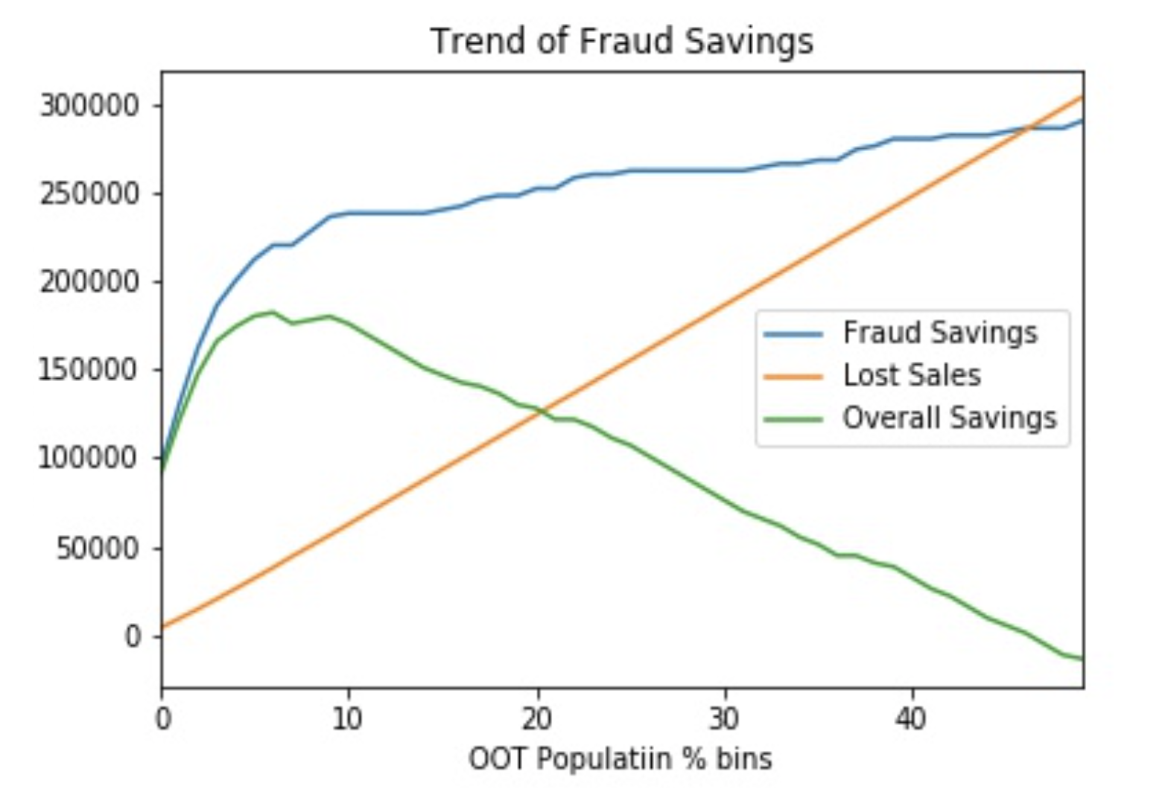
Fraud Savings Calculation Suggests Score Cutoff
Include this chart in your paper
We recommend a score cutoff at 5%
Assume $2000 gain for every fraud that’s caught (blue curve)
Assume $50 loss for every false positive (good that’s flagged as a bad) (red)
Calculate the Fraud Savings, Lost Sales, Overall Savings (green), and make a recommendation for where the client should set a score cutoff

Slide 22
Fraud Scores Increase With Activity
records
Count variables
card xxx
1
As the same card # is seen multiple times the count variables increase
card xxx
2
time
card xxx
3
As the count variables increase, the fraud score increases
card xxx
4
card xxx
5
The first few transactions look normal, then they start to look more suspicious and the fraud score rises
Fraud Score
card xxx
6
card xxx
7
Transaction count with that card #
Fraud scores rise as they see more activity at the entity level (card #, merchant #, card at that merchant…)

Slide 23
Plots to Include in Report 3
One plot is over time, the other is over transaction count
Put arrows to connect example transactions
Include two examples, one for a card number and one for a merchant
Card number= xxxxxx
Merchant number = xxxxxx
82 transactions occur over the year
Fraud Score
28 transactions occur over 2 days, and we don’t have the time of day when they occurred.
Fraud Score
Note – this is a bad plot. It should only cover the days of the transactions
Day in month
Month in year
All these transactions happen across 2 days. The score rises quickly while 7 transactions happen on the first of 2 days.
Fraud Score
Fraud Score
Small bunching of applications gives a slightly elevated fraud score
Large bunching gives a very high score
Transaction count with that card number
Transaction count with that merchant #

Slide 24
How to Make the Best Model (1)
Out of time validation
Training, testing
Available data
Time
Today
Work hard to maximize testing performance with minimal model complexity
The OOT performance is what we can expect when we implement the model
Can we improve on this? Maybe…

Slide 25
How to Make the Best Model (2)
Out of time validation
Training, testing
TRN, TST
OOT
Available data
Facts:
Time
Today
The more data we train on the more robust the model.
Training on the most recent data makes the model most likely to perform well in the future.
Do cross validation with the TRN_TST data, run ~10 times, average results
Use this method to select your favorite model type.
Continue, tuning the hyperparameters on your favorite model using 10 runs for each test. Select and “freeze” your favorite hyperparameters.
When done, use those hyperparameters to build a new model with TRN, test on TST. Put these numbers/tables in the report for the TRN and TST tables.
Rebuild the final model using all of TRN_TST with the frozen hyperparameters, and test on OOT. Put this OOT table performance in the report.

Slide 26
How to Make the Best Model (3)
You won’t do this for Project 3, but if you had to deliver/implement your best model you could do this
Out of time validation
Training, testing
TRN, TST
OOT
Available data
Time
Today
IF you are convinced that your model is robust, not overfitting, and minimal complexity, you can “freeze” the architecture and training hyperparameters, and rebuild one final model using all the data (TRN,TST,OOT).
This will give you the best possible model for implementation.
There is no test data so you don’t know how well it will work. You don’t put any of these results in your report, you only use it for implementation.
How can you convince yourself this is OK?
Implement it and carefully watch performance, compare to previous OOT.
Build model on TRN+TST, evaluate on OOT and compare to previous OOT performance. Should be better.
This should only be done under the supervision of experienced modelers.

